Slide 1



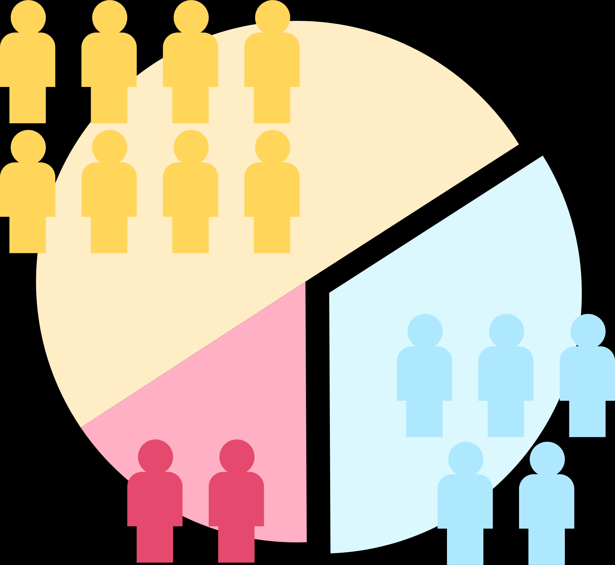
PROJECT SEMESTER 2
EDA and Build Classification Models for Customer Segmentation with PySpark and Spark
Presented by
Quynh Lam, Tien Loc, Huu Thang
Instructor :
Ho Nhut Minh
Class :
DT2307L-NK

Slide 2






Table of Contents
1
Project Purpose
2
Project Scope
3
Preprocessing & EDA
Feature Engineering & Maching Learning
4
Conclusion and Recommendations
5

Slide 3



Project’s Purpose
Business Problem:
Low conversion rate despite running ads
LOW MARKETING CAMPAIGN PERFORMANCE
High advertising costs with little effectiveness
No responses to marketing emails or messages
Improve Marketing Performance
Enhance Customer Experience
Revenue Growth Target

Slide 4


Project's Purpose
This project mainly focuses on EDA & Clustering with PySpark & Spark MLlib.
Clustering includes the implementation of K-Mean Algorithm and other clustering algorithms
Tech stack:
Language: Python
Package: PySpark
Services: Spark
Run on Google Colab

Slide 5

2. Project Scope
Data Overview
data.csv (CSV file)
Transaction records (From 01/12/2010 to 09/12/2011)
541909 rows, 8 columns
Categorical
Numerical
TimeStamp
InvoiceNo
Stock Code
Quantity
InvoiceDate
Description
CustomerID
UnitPrice

Slide 6



2. Project Scope
Project Workflow
Transform Data & EDA
Local Computer
Google Drive File Store
Colab Notebook
Get Insight
Machine Learning
User Interface

Slide 7

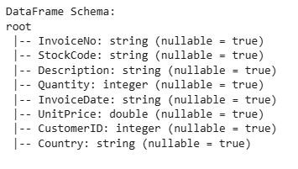

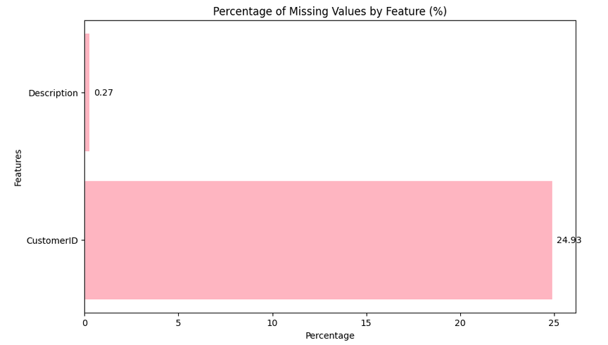
3. Preprocessing and EDA
General Information of Data
Handle missing data
24.93% missing values of all Customer
0.27% missing values of Description
Remove Duplications
Change Datatype

Slide 8
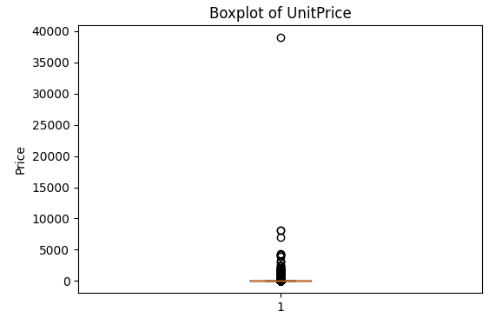
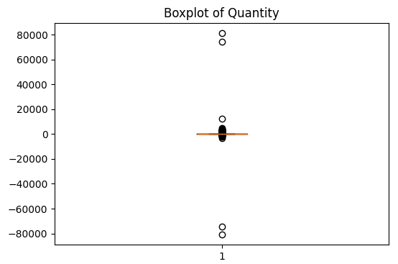
UnitPrice
Replace the UnitPrice = 0 with mode of UnitPrice correspond to the same StockCode
Numerical
Variables
Quantity
Remove Negative Values of Quantity correspond with Cancel Order without Order Transaction

Slide 9



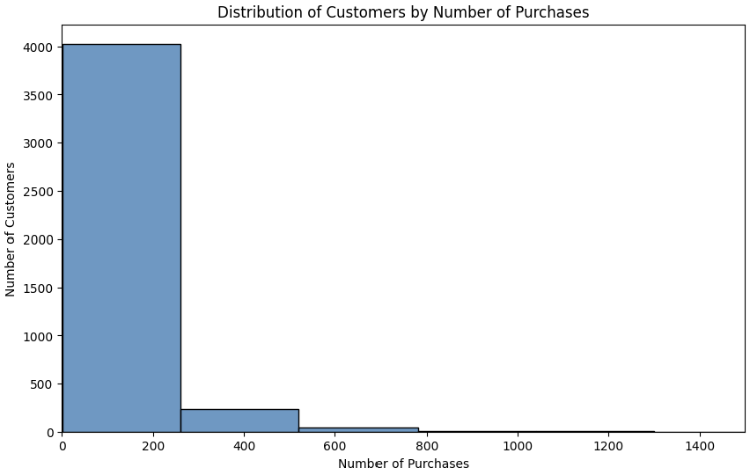
EDA
Customer Analysis
Insight:
Right-skewed Distribution
Most customers have fewer than 200 orders.
A few have over 600-1000 orders, creating outliers.

Slide 10
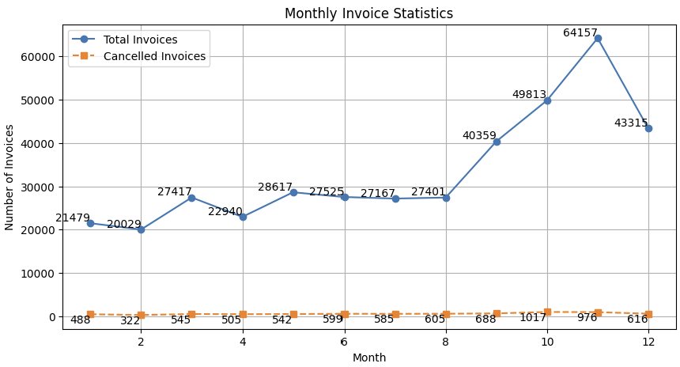
EDA
Invoice Analysis
Insight:
Transactions increase sharply in Q4, likely due to year-end shopping.
Canceled invoices remain stable, indicating transaction consistency.
The decline in December, possibly due to seasonal factors or sales policies

Slide 11
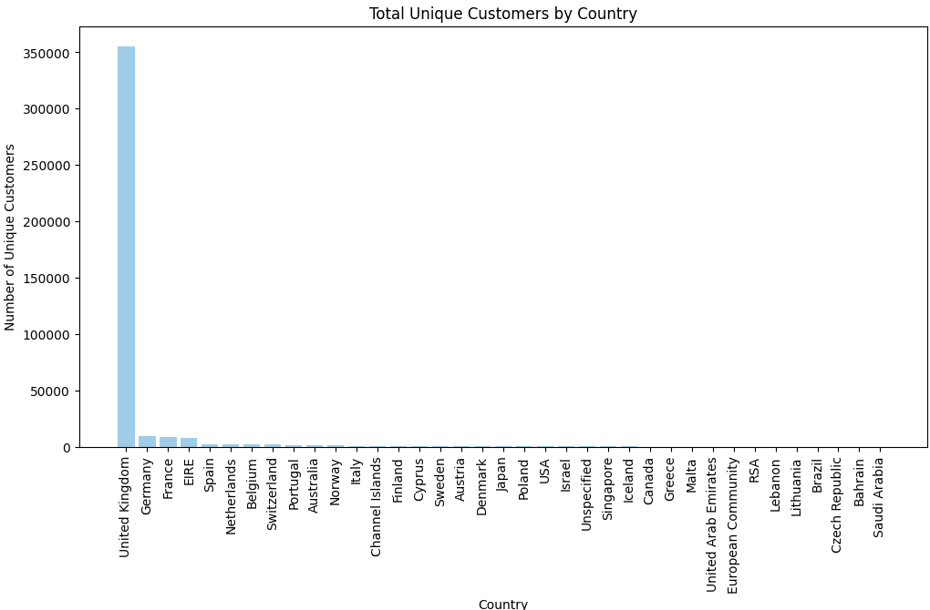
EDA
Country Analysis
Insight:
The business mainly serves the UK, with minimal presence elsewhere
Expanding internationally requires a targeted customer strategy.

Slide 12
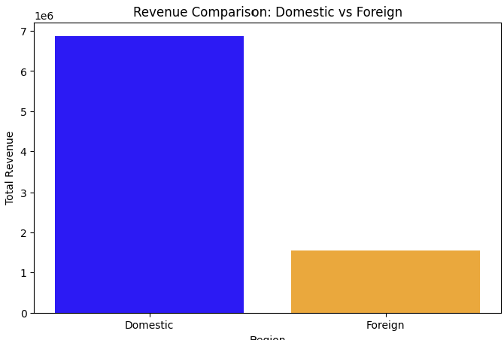
EDA
Revenue Analysis
Insight:
Domestic revenue dominates (~7 millions)
International revenue is still low (~1.5 millions)

Slide 13
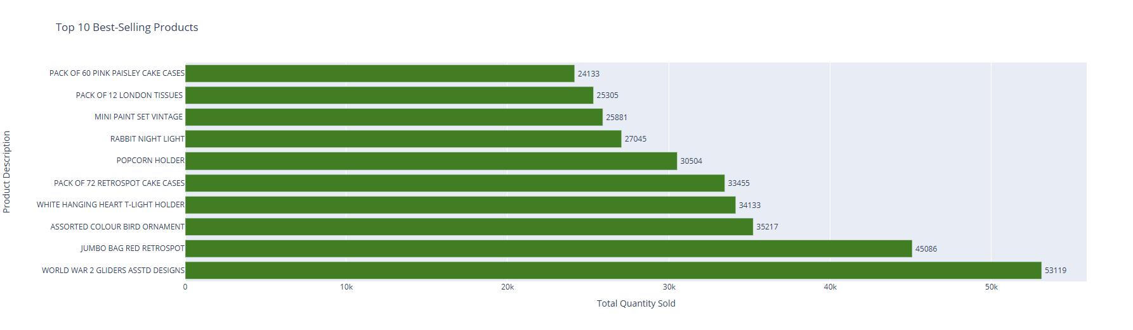
EDA
Product Analysis
Analyze product trends (product type, style)
Optimize product catalog
Pricing and promotion strategy

Slide 14
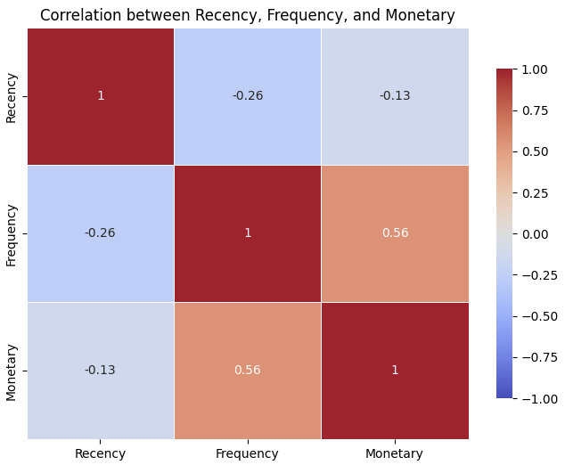
4. Feature Engineering & Machine Learning
RFM Model
Recency (R)
When was the last time that a customer bought the product?
Frequency (F)
How frequent the customer buy the product?
Monetary (M):
How much the customer pay for the product?

Slide 15

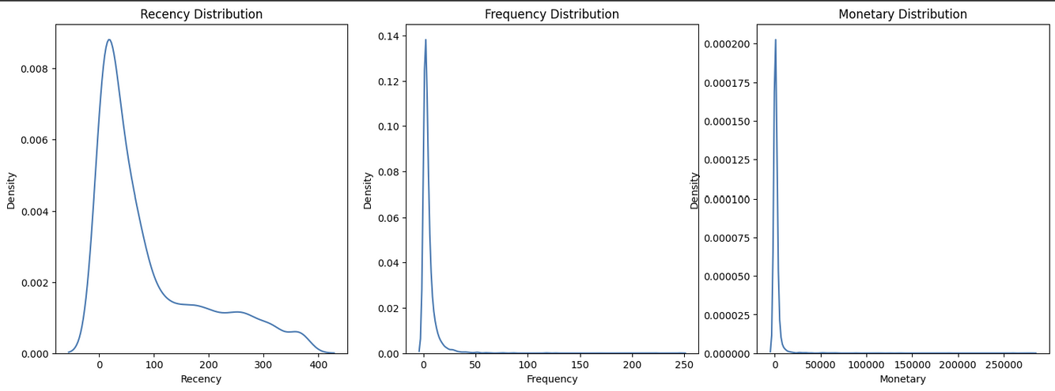
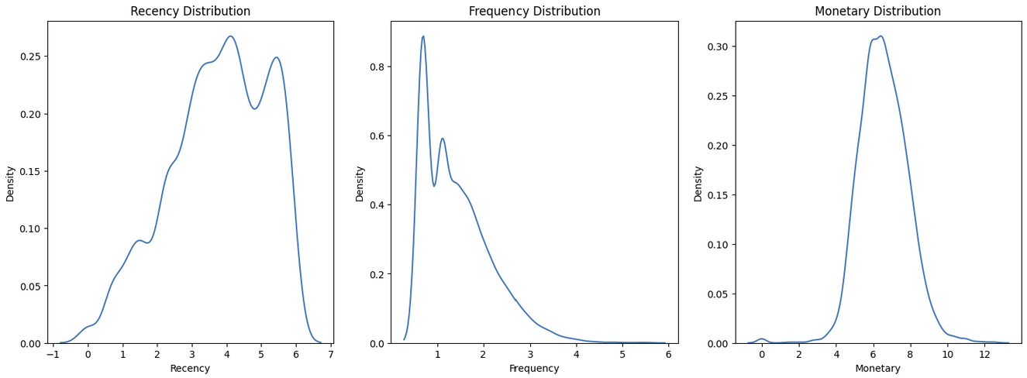

Machine Learning Model
01
DATA TRANSFORMING
Right-skewed (Skewness > 0)
To achieve a more normal distribution, transform by Log

Slide 16



Machine Learning Model
02
SPARK ML PIPELINE
VectorAssembler
StandardScaler
KMeans
01
Merge multiple feature columns into a single vector column
02
Standardize data, helping to bring features to the same scale
03
K-Means clustering model with k=4 on RFM data
Pipeline

Slide 17
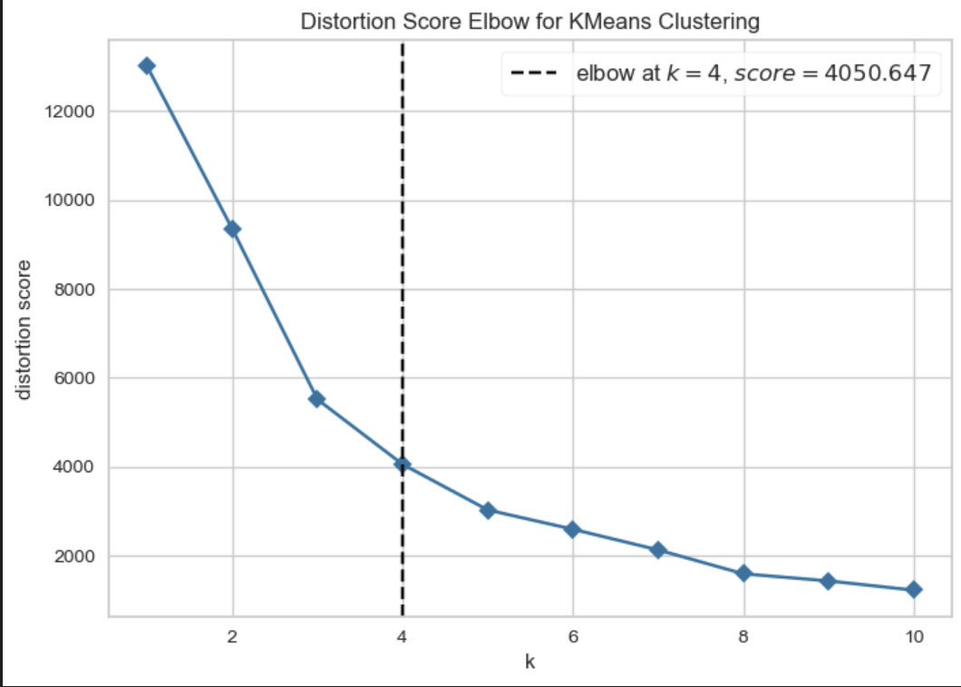
Machine Learning Model
EVALUATE MODEL & MODEL SELECTION
03
Within-Cluster Sum of Squared Errors (WSSSE)
Cluster tightness
The lower the WSSSE value → The better the cluster
Silhouette Score
Evaluate clustering quality (separation between clusters)
s is close to 1 → Good clustering.
Davies-Bouldin Score
Measures the degree of overlap between clusters
The lower the DB, the better the cluster (less overlap)
Calinski-Harabasz Score
Evaluate clustering quality
The higher the CH Score, the better the clustering

Slide 18
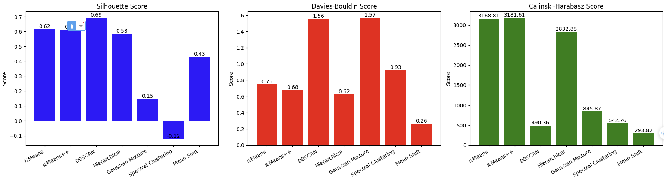
Machine Learning Model
EVALUATE MODEL & MODEL SELECTION
03
Best choice: K-Means++ or K-Means.

Slide 19
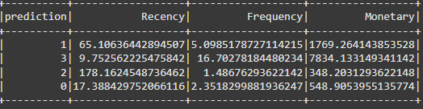
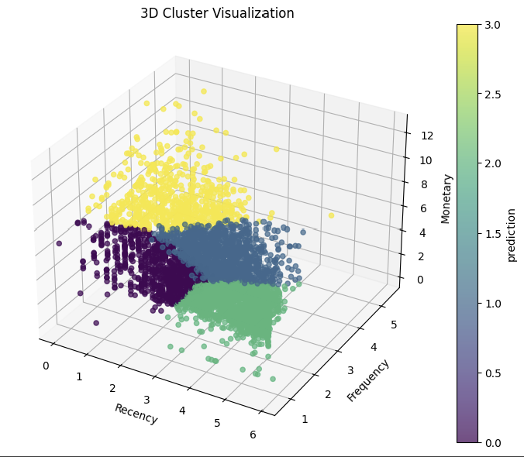
Clustering Results
Cluster 0: New Customer
Buy recently but few times, low spending
Cluster 1: Potential Customer
Buy is not too often but has the potential to spend.
Cluster 2: Churned Customer
Haven’t returned in a long time and have very low purchase activity.
Cluster 3: VIP Customer
They purchase frequently and spend a lot

Slide 20


5. Conclusion and Recommendations
Group 0 (New Customers):
Engage them with welcome programs and next-purchase discounts to convert them into loyal customers.
Group 1 (Potential Customers):
Encourage them with special offers, discounts, and incentives to increase purchase frequency.
Group 2 (Churned Customers):
Use reactivation campaigns (emails, promotional vouchers, surveys to understand why they left).
Group 3 (VIP Customers):
Implement VIP benefits, loyalty rewards, and personalized offers to retain them.

Slide 21

Thank You

